Slide 1
US Airline Data ANALYSIS

Slide 2
Agenda
Problem Statement
Data overview & Methodology
Analysis & Findings
Recommendations
Questions

Slide 3
Problem Statement
In this project, we are analyzing the performance of US domestic airline flights to improve flight reliability thereby improving customer reliability.

Slide 4
Data overview & tools used
Provided us data containing, airline, flights, state, cancellation code, travel time, month, year.
PYTHON – Data cleaning, analysis & visualization

Slide 5
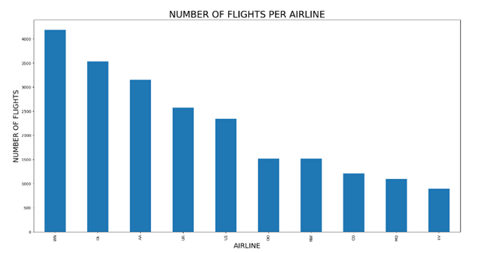
Analysis & Findings
Analysis –
Number of flights per airline.
Insight -
Flights with airline WN are more in number when compared to others.

Slide 6
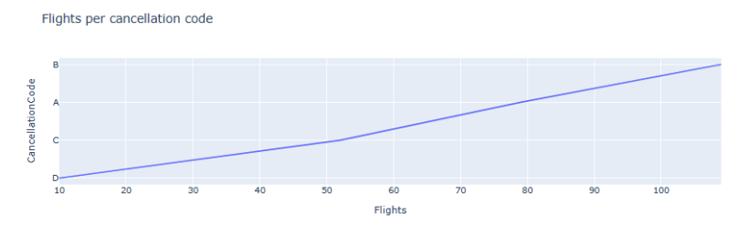
Analysis –
Number of flights per cancellation code.
Insight -
More number flights cancelled are having code B.

Slide 7
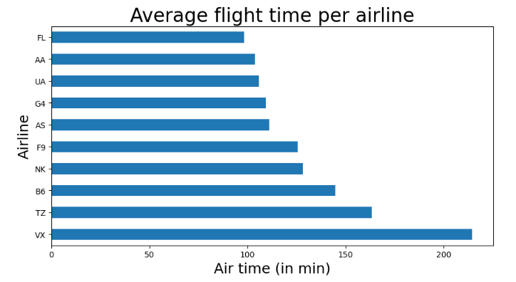
Analysis –
Average flight time per airline.
Insight -
The average flight time for many airlines is around 100 minutes.

Slide 8
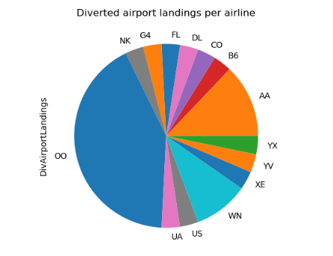
Analysis –
Diverted airport landings per airline.
Insight -
Airlines with code OO has more numbers of aircraft diversions.

Slide 9
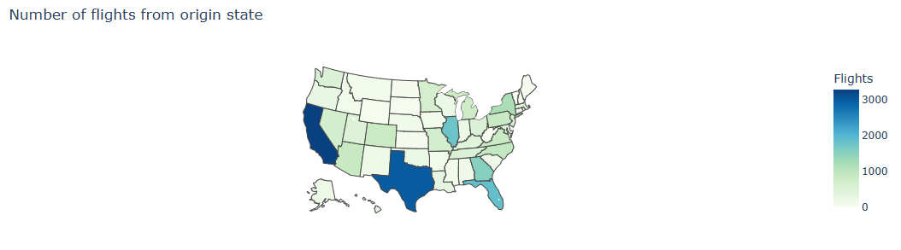
Analysis –
Number of flights starting from states..
Insight -
California has more number of flights followed by Texas..

Slide 10
Recommendations
Flight cancellations can be reduced by taking effective measures on code B.
Aircraft diversions for airline ‘oo’ needs to be reduced and measures should be taken for the causes.

Slide 11

Questions

